Slide 1
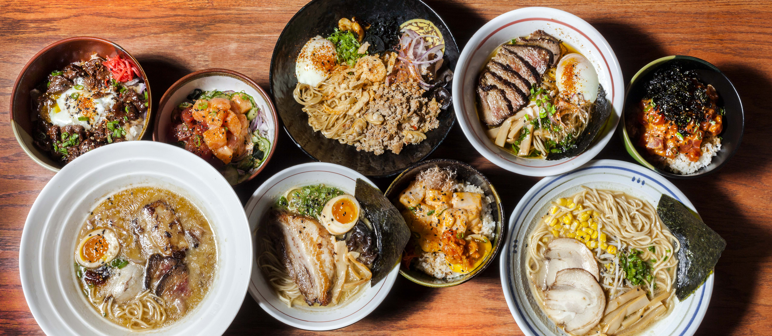

Net Sales Prediction
PRESENTED BY:
Jenny Zhihan Wang, Nazarat Hossain, Ziwei Zhao

Slide 2



Meet Our Team.
Jenny Zhihan Wang
Nazarat Hossain
Ziwei Zhao
B.S. in Information Management
2.5 years IT project management experience
B.S. M.S in Electrical and Electronics System Engineering
5 year Quality Control and Quality Assurance experience in IT industry
B.S. in Applied Mathematics and Economics
2-year retail banking and 6+ years’ experience in hospitality industry

Slide 3
Our Agenda.
PART ONE
Company Background
PART TWO
Problem Statement
PART THREE
Data Overview
PART FOUR
Data Analysis and Sales Forecast
PART FIVE
Future Work

Slide 4


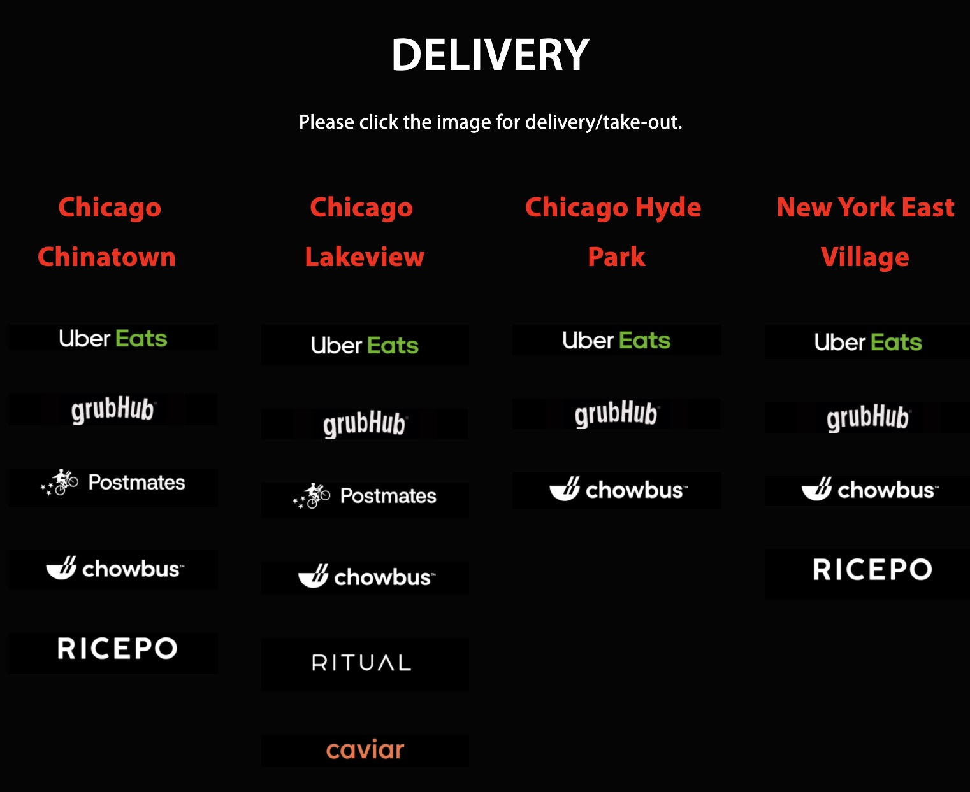
Company Background.
Strings Ramen is a ramen chain restaurant which brings a piece of authentic Japanese culture and culinary tradition to the heart of Illinois and Wisconsin, Indiana and New York to be. It has voted as Chicago’s Best Ramen Restaurant, top 10 ramen stores in America and home of the “Monster Hell Ramen Challenge”. Strings make fresh noodles daily using only their unique dough mixer and noodle maker imported straight from Japan.

Slide 5
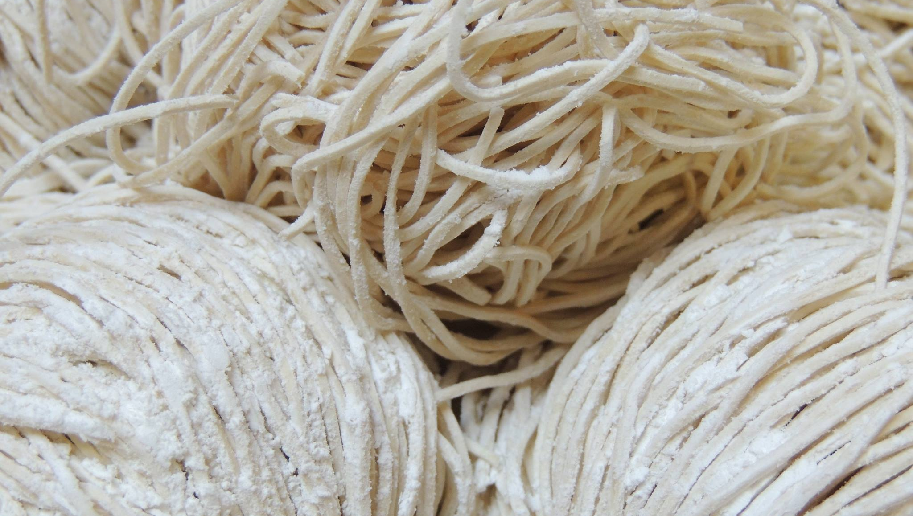


Problem Statement.
Strings Ramen has attained remarkable achievements during the past four years opening of its first store. After serious consideration, the founder and owner decided to establish a franchise brand of the store, kept expanding in mid-west market and establish a flagship store in north-east market. Based of the historical data of three existing locations, the owner and other investors would like to forecast the future sales in order to develop new sales approaches, marketing plan and drive strategic decisions more effectively and efficiently for overcoming challenges in the markets.
Predict Net Sales of the chinatown location to better allocate the resources
Notes:
1. What is the monthly sales forecast for the 3 existing ramen restaurant locations for the next 12 months?
2. What are the potential geo-demographic factors that may impact the Chicago stores (Chinatown, Lakeview) sales in the mid-to-long term run? (Geo-demographic factors will be extracted from social media, Strings Ramen has been proactively responding customer posts/tags)
3. Is the sales forecasting model user-friendly and adaptive that after this capstone project ended it allows continuous development and improvement for forecasting needs?

Slide 6

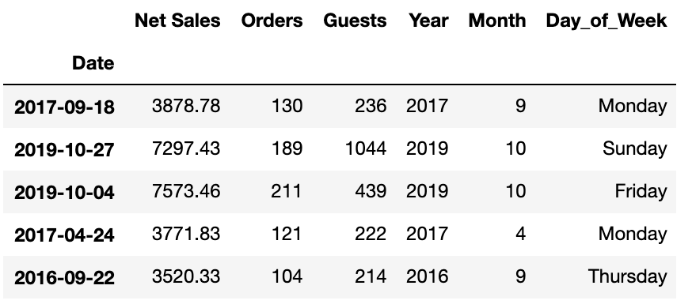








Data Overview.
The POS data date range for Chinatown location is: 2/19/2015~12/31/2019
TOAST, an Android-based restaurant point of sale and management system software, that used in every store under Strings Ramen Inc. since Feb 2015. TOAST provides real-time cloud data including sales, menu, inventory and labor.
Notes:
For each transaction, TOAST holds unique payment id and order id, with more than 40 attributes, supporting analysis based on sales summary, payments, shifts, servers, order details, inventory level, table turnover and menu group summary.
、
GrubHub, Eatstreet, Chowbus, Ricepo, Postmates, UberEats, Amazon
For each transaction, it holds unique payment id and order id, with more than 40 attributes, supporting analysis based on sales summary, payments, shifts, servers, order details, inventory level, table turnover and menu group summary.
The dependent variable is the net sales per ramen store in the restaurant chain. Sales volume is the number of units sold per customer visit during a period, and broadly indicates how well the individual store is performing. Individual store’s share of the chain, or proportion of total sales, is defined as its sales volume divided by the total sales volume of the entire chain.
• Chinatown: 2/19/2015~Now

Slide 7
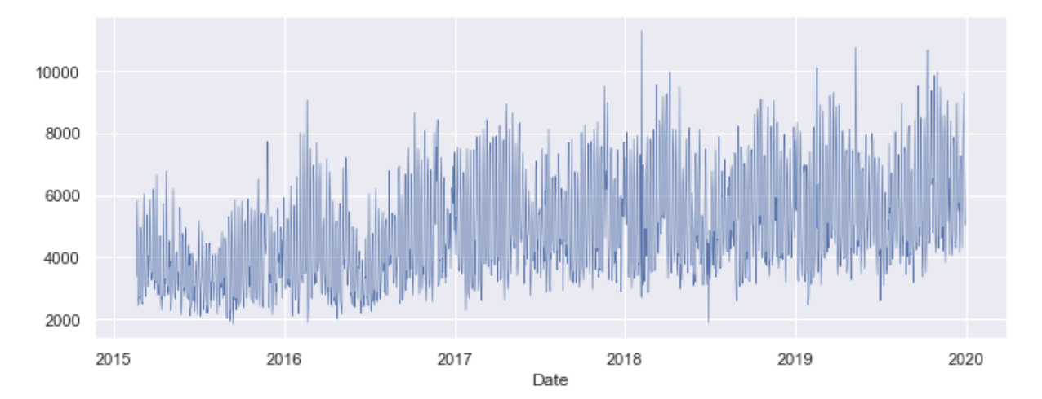
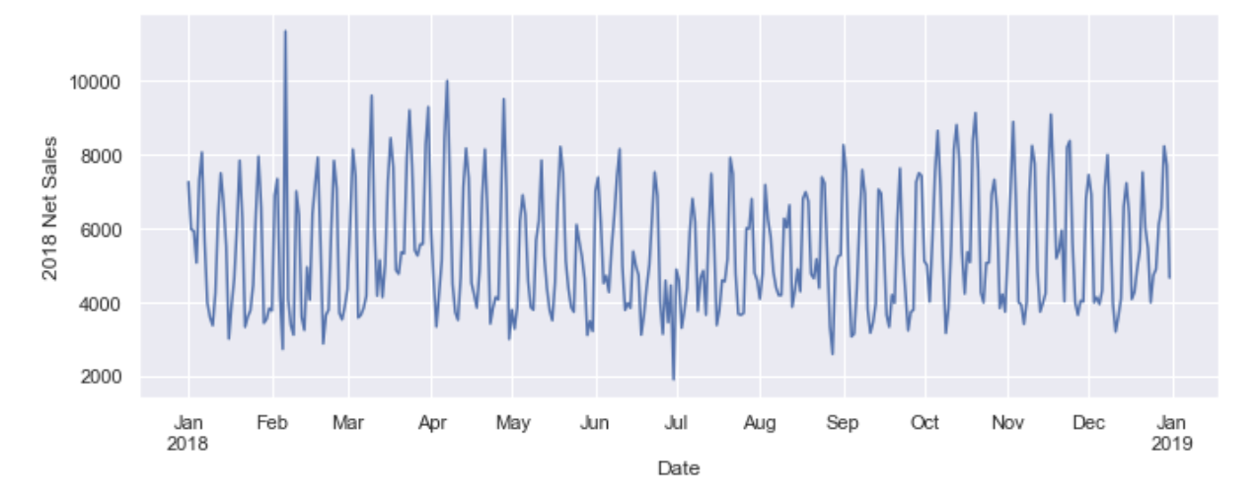
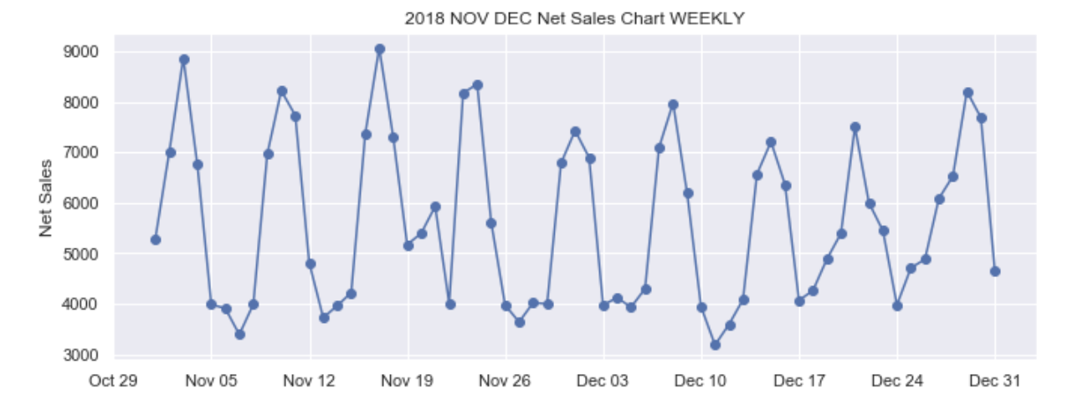
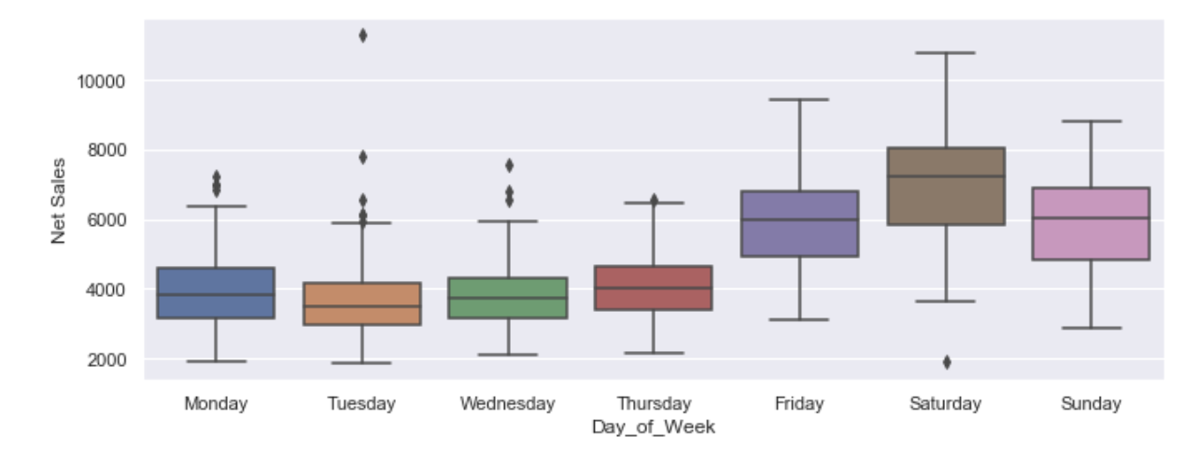
2015 - 2019
1 Yr
2 Ms
Weekly
Notes:
Life time net sales chart
Trend going up each years, and potential seasonality
- Strong seasonality

Slide 8
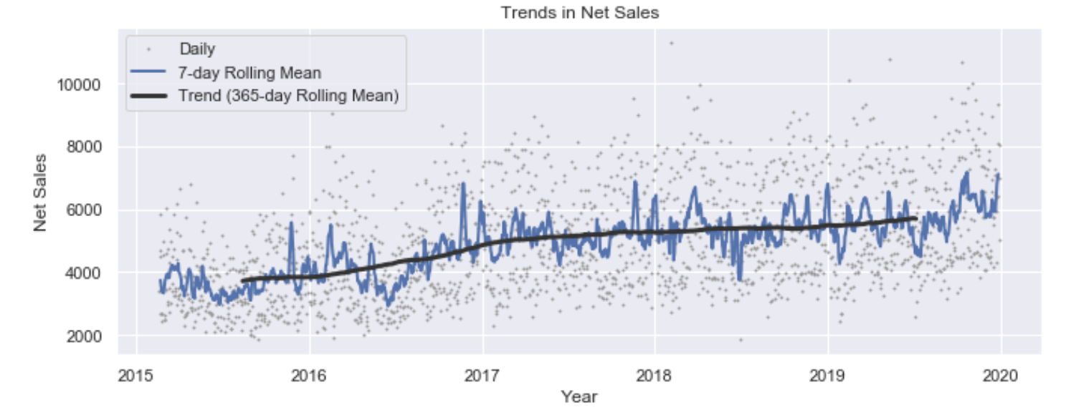
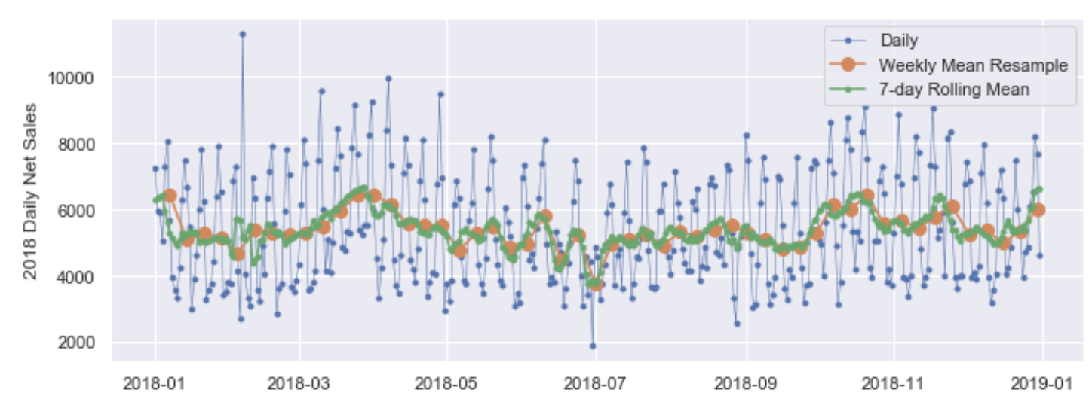
2015 - 2019 Trends in Net Sales
2018 Weekly Mean and 7-day Rolling Mean
Notes:
Life time net sales chart
Trend going up each years, and potential seasonality
- Strong seasonality

Slide 9
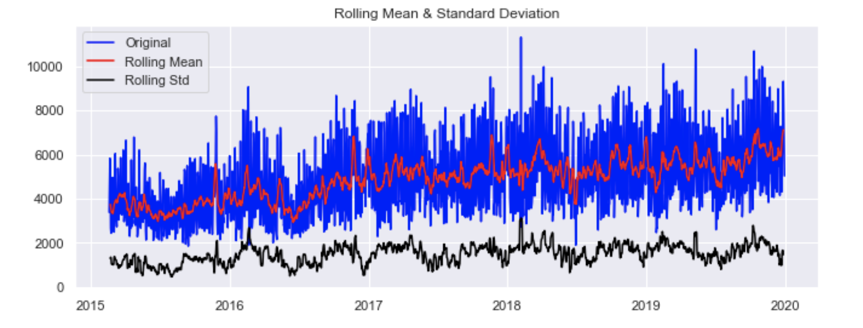
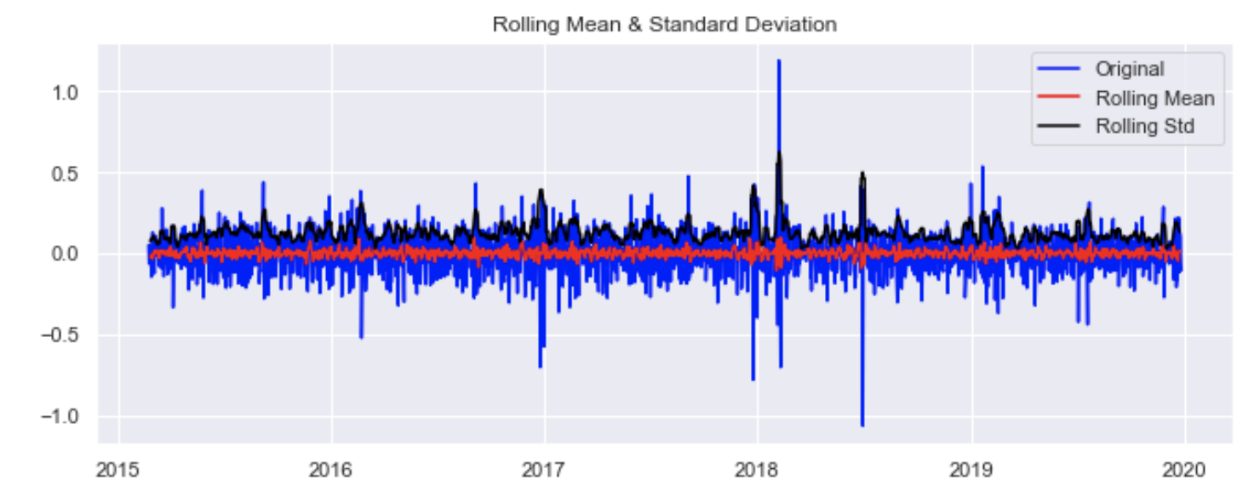
2015 - 2019 Rolling Mean and Standard Deviation
After Decomposition
Notes:
Life time net sales chart
Trend going up each years, and potential seasonality
- Strong seasonality

Slide 10
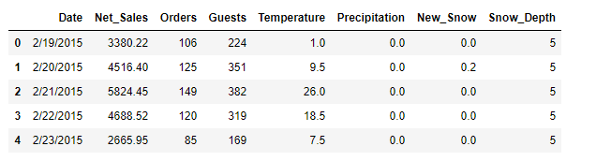
Net Sales Prediction – Linear Regression
Add weather data
Temperature
Precipitation
New Snow
Snow Depth
Source: https://www.noaa.gov/weather
Total data :1,777 rows
Train/Test Split : 80/20
Train Data : 1,441
Test Data : 356

Slide 11
Net Sales Prediction - Linear Regression.
Regression | MSE | R^2 | Explained Variance
Linear Regression with sklearn | 260253.7 | 0.9072 | 0.9075
Gradient Descent (Mini-Batch size 50) | 260178.4 | 0.9072 | 0.9075
Gradient Descent (Mini-Batch size 200) | 259007.1 | 0.9076 | 0.9080
Gradient Descent (Mini-Batch size 500) | 254657.8 | 0.9092 | 0.9101
Gradient Descent (Mini-Batch size 600) | 257746.5 | 0.9081 | 0.9102
Support Vector Machine | 287366.9 | 0.8975 | 0.9002

Slide 12
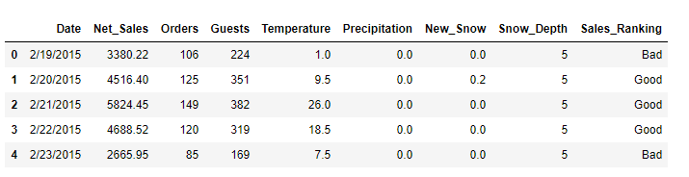
Net Sales Prediction - Classification
Add sales ranking class to the data
Net_Sales < 40percentile : Bad
Net_Sales < 60percentile : Average
Net_Sales < 80percentile : Good
Net_Sales > 80percentile : Excellent

Slide 13
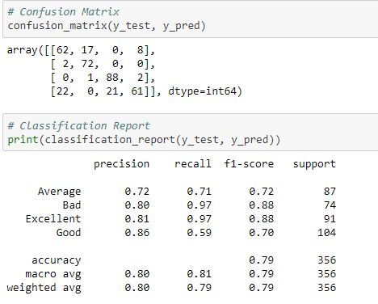
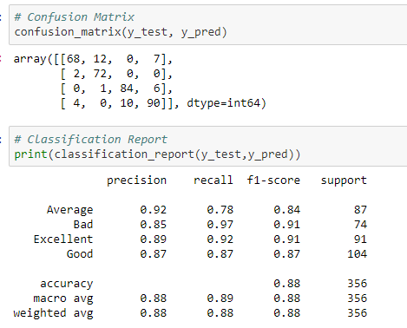
Net Sales Prediction
- Logistic Regression - Random Forest.
Accuracy 81% in train data and 79% in test data
→Model performs well
Accuracy 100% in train data and 88% in test data
→ Overfitted and unstable

Slide 14
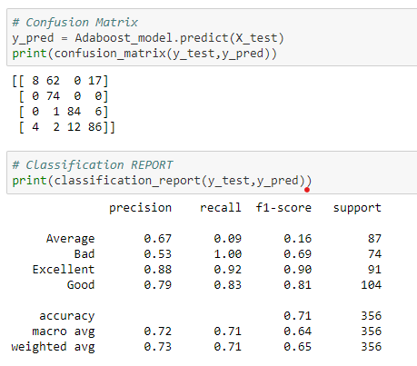
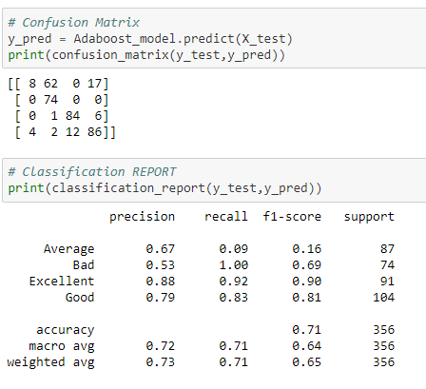
Net Sales Prediction
- AdaBoost - Gradient Boosting
Accuracy 70% in train data and 71% in test data
→ Stable but low accuracy
Accuracy 70% in train data and 71% in test data
→ Stable but low accuracy

Slide 15
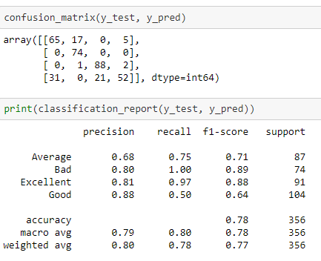
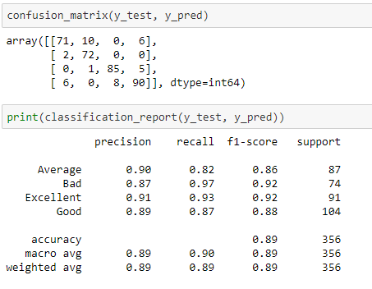
Net Sales Prediction
- Linear SVM - Linear SVM + Grid Search
Accuracy 80% in train data and 78% in test data
→ Performs well
Accuracy 87% in train data and 89% in test data
→stable and performs very well
Notes:
Accuracy in Class “Average” and “Good” is poor
Accuracy 86% in train data and 84% in test data
The model performs well

Slide 16
Comparison of Classification Models.
Model | Accuracy in Train (%) | Accuracy in Test (%)
Logistic Regression | 81 | 79
Random Forest | 100 | 88
AdaBoost | 70 | 71
Gradient Boosting | 70 | 71
XGBoosting | 70 | 88
LinearSVM | 80 | 78
Linear SVM + Grid Search | 87 | 89
Polynomial SVM + Grid Search | 87 | 86
RBF SVM + Grid Search | 87 | 89
Notes:
Accuracy in Class “Average” and “Good” is poor
Accuracy 86% in train data and 84% in test data
The model performs well

Slide 17


Future Works.
Add additional sales forecast for holiday and events based on the historical data, and provide sales projection for inventory management
Collect customer information and list of all items bought by customers, and apply association Rule to determine which groups of items are consistently purchased together and use this data for adjusting store layouts, cross-selling, promotions based on statistics
Combine Social Media data from Instagram, Facebook etc. for user profiles and forecasts
Notes:
It should be noted that the forecasts produced are only as good as the data that are used. Forecasting accuracy depends on various factors and as can be seen from the results, equally accurate forecasts for all three restaurants are not possible as the date ranges of data provided by each location vary. It is therefore recommended that restaurant stakeholders planning on using the forecasting model/models in the future, the team will keep a detailed guideline of the potential enhancement and steps of how to implement the forecasting models into t he current business process that Strings has.

Slide 18
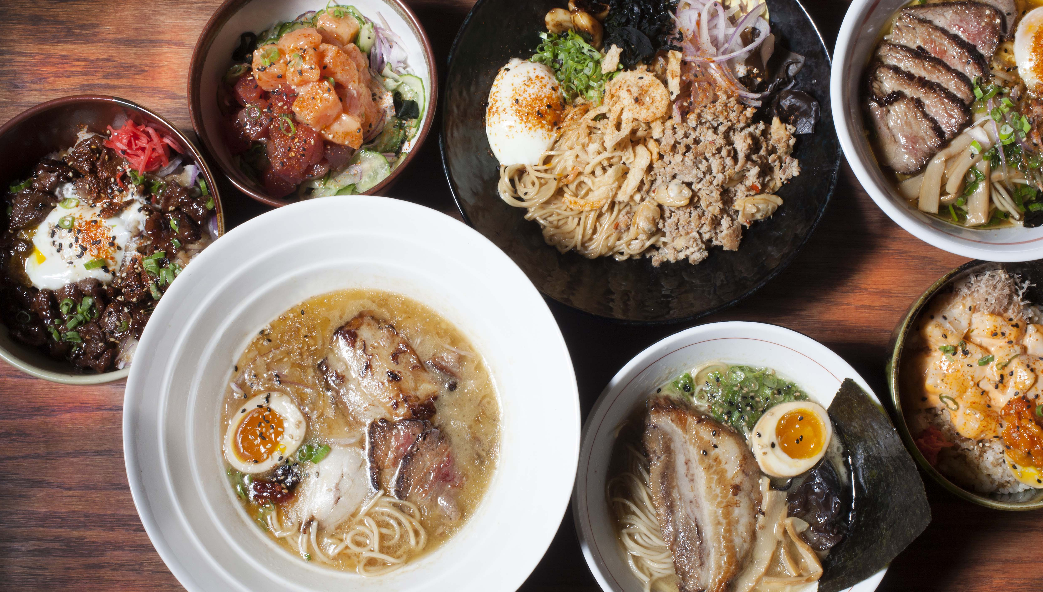
Thank You.

